Slide 1
HxH Tracking System
Chenyu

Slide 2
Overview
Three Main functions: 1. Hourly automatically produce and record data. 2. able to stop at any time to change over 3. Generate reports
3 main steps: 1. Click “start work” to enter the production page. 2. Select your building # and cell #, Select your name and then press “add operator” button. 3. Select the part # for the current time span. 3.1 When you finished this hour the system will automatically pop up a message box. 3.2 Or you may need press “job complete” to start a changover time

Slide 3
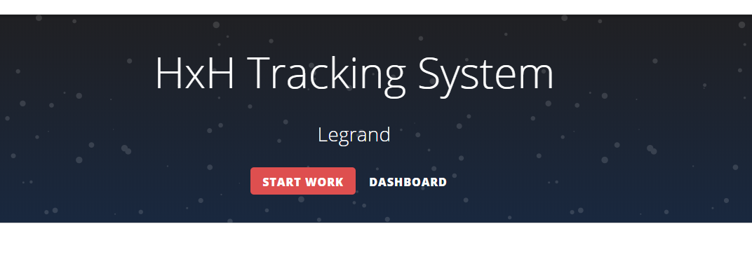
Step 1
1. Click “start work” to enter the production page.

Slide 4

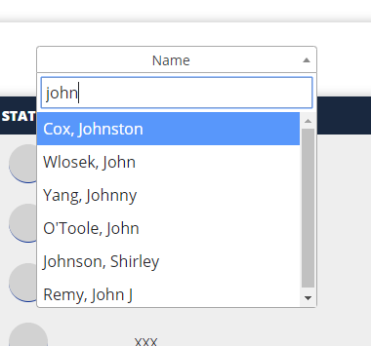

Step 2
Select your building # and cell #

Slide 5
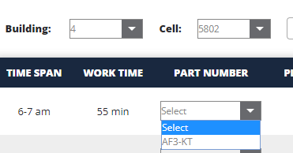
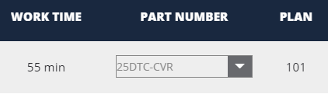
Step 3
Select the part # for the current time span and then the plan # will changed based on the worktime and the part number.

Slide 6
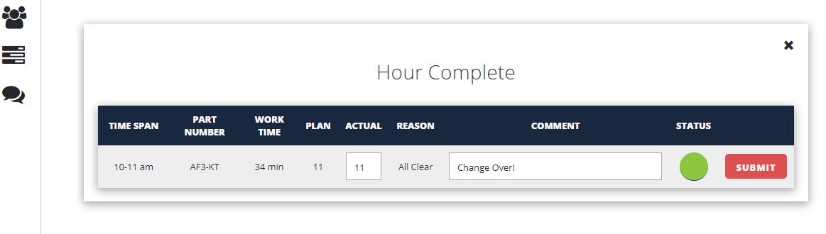
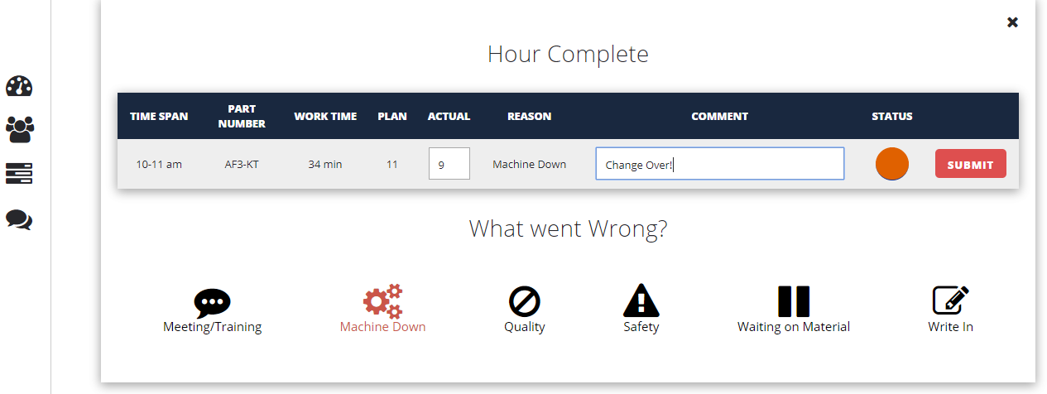
Step 3.1
The operator need to fill the form up, they are supposed to input the actual pieces they have done, the comments(optional), the status and the reason if the status is red

Slide 7
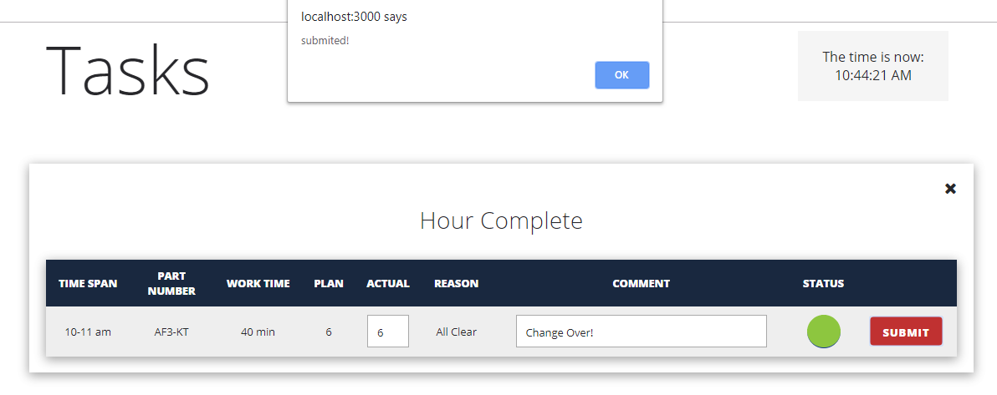
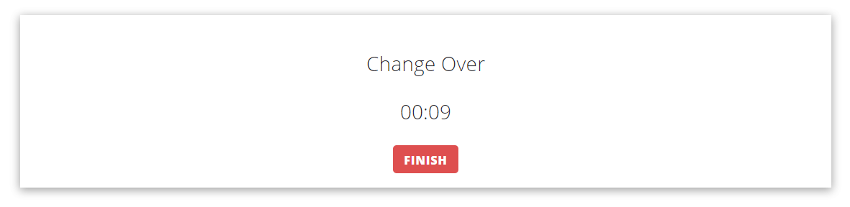
Step 3.1
Or, operator can finish their job at any time in the time span when they are going to change over.
Note the name of the page is changed to “Production”

Slide 8
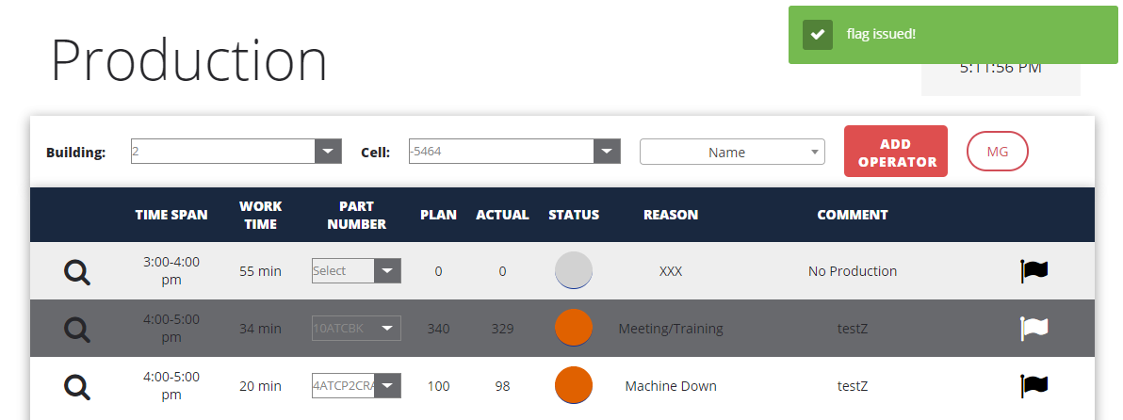
Step 3.3
If, operator find any error in the record they have submitted.they can flag this document by typing/clicking the flag icon, type/click again to unmark the document.

Slide 9
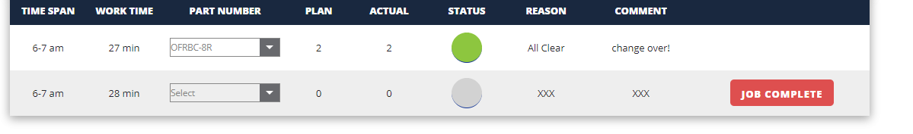
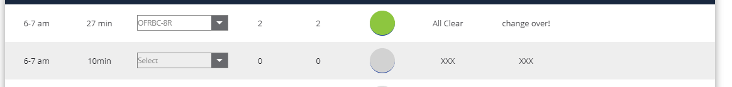
How Work Time Changed
Note: In this example the change over time is counted by the timer and the value is 18 min.

Slide 10
Thank you!

